Slide 1
ODATA – the best way to REST

Slide 2

AGENDA
OVERVIEW OF ODATA OASIS STANDARD
URL CONVENTIONS
ADOPTERS IN ANALYTICS AND SUPPORTING Architectures
ODATA @ PROGRESS

Slide 3
OVERVIEW OF ODATA OASIS STANDARD

Slide 4

What is OData?
An open protocol to allow the creation and consumption of queryable and interoperable RESTful APIs in a simple and standard way.
Started by Microsoft in 2007
Ratified as an OASIS standard on February, 2014
Progress was first member of OData Technical Committee following Microsoft

Slide 5
REST is great, But..
It’s a style – not a standard
Metadata support?
Limited querying capabilities

Slide 6
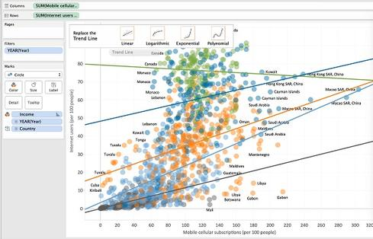
Why OData?
Operations built on REST principles
Uniform URL conventions
Surfaces metadata by default
Interoperability

Slide 7
URL Conventions
http://services.odata.org/OData/OData.svc
\__________________________________/
|
service root URI
http://services.odata.org/OData/OData.svc/Category(1)/Products?$top=2&$orderby=name
\__________________________________/ \________________/ \__________________/
| | |
service root URI resource path query options
Notes:
URI

Slide 8
URL Query Conventions
$SELECT
/Products?$select=*,Category/Name
$FILTER
/Suppliers?$filter=Address/City eq 'Redmond’
$ORDERBY
/Products?$orderby=ReleaseDate asc, Rating desc
$EXPAND
/Products?$select=*,Category/Name&$expand=Category
$TOP $SKIP
/Products?$top=5&$skip=2
Notes:
OData supports basic SQL constructs like
o Select List ($select)
o Where Clause ($filter)
o Order By ($orderby)
o Scalar functions (min, max, contains, etc) – In $filter and orderby only.
o Stored Procedures and Functions (actions and functions)
· The concept of joins is loosely supported by the $expand query option.
o Joins typically require a defined relationship between the entities being joined.
o OData 4 does allow the expanded result to be shaped, filtered and ordered ($select, $filter, $orderby)

Slide 9
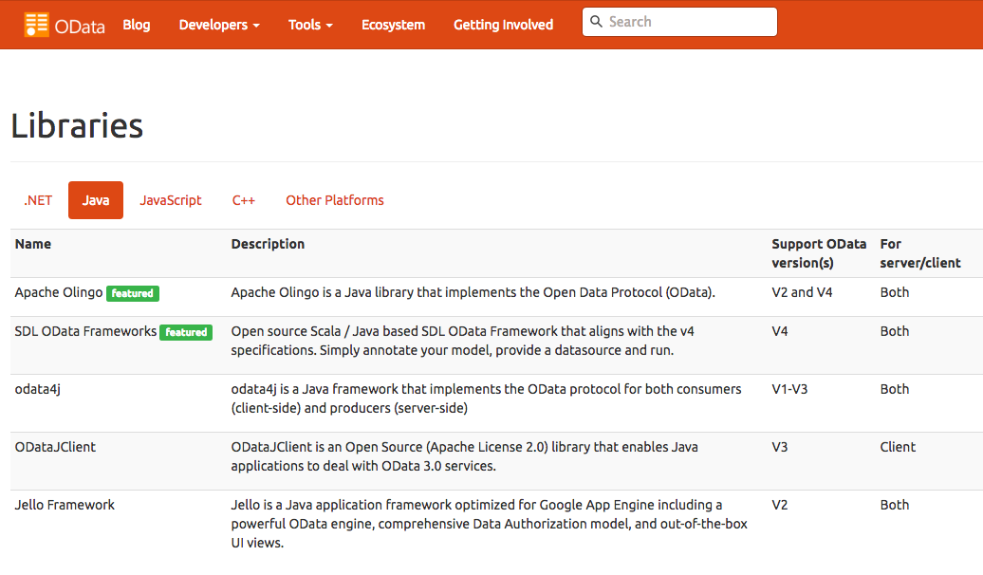
OData Libs - http://www.odata.org/libraries/
.NET, Java, Javascript, C++
OData4j
Apache Olingo
ODataJS
Node-odata
ODataCpp
RESTier
WCF Data Services
Visual Studio Lightswitch
ODataPy

Slide 10
ADOPTERS IN ANALYTICS AND SUPPORTING Architectures

Slide 11









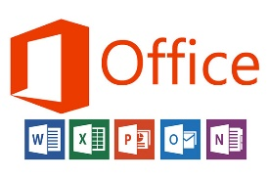






















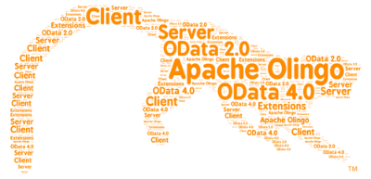


















Broad Adoption

Slide 12
ODATA @ PROGRESS

Slide 13
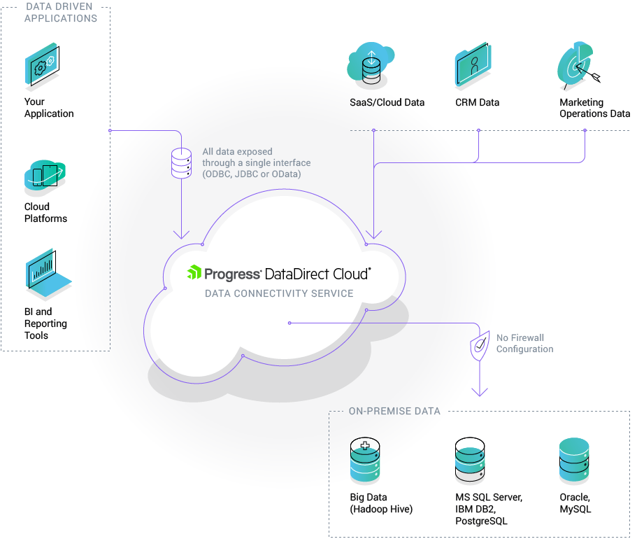
Progress DataDirect Cloud
OData
Notes:
Ecosystem includes
Libraries
Native OData producers
Third Party ESB type apps such as SAG webMethods, Mulesoft, etc

Slide 14
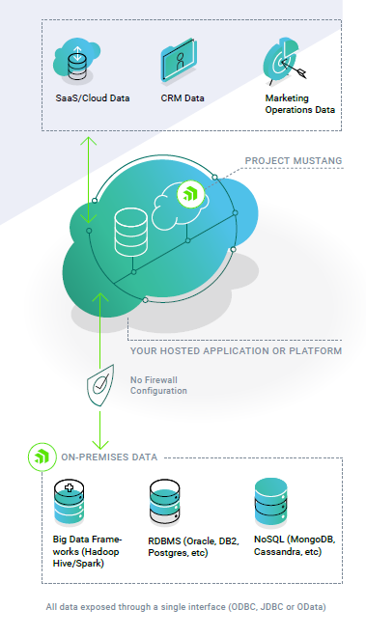
Project Mustang Beta
Notes:
Ecosystem includes
Libraries
Native OData producers
Third Party ESB type apps such as SAG webMethods, Mulesoft, etc

Slide 15
DEMO

